Slide 1
Let’s Begin with Android Programming
Pertemuan 5
Notes:
This presentation demonstrates the new capabilities of PowerPoint and it is best viewed in Slide Show. These slides are designed to give you great ideas for the presentations you’ll create in PowerPoint 2010!
For more sample templates, click the File tab, and then on the New tab, click Sample Templates.

Slide 2
Today’s Menu
Simple
App
Activity
Lifecycle
XML
Introduction

Slide 3
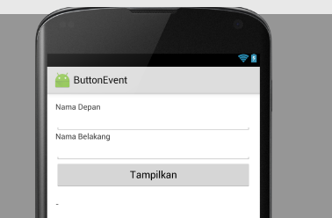
App UI

Slide 4
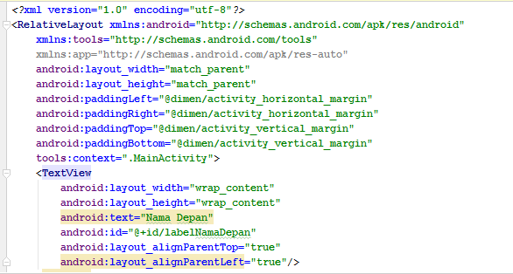
File : activity_main.xml

Slide 5
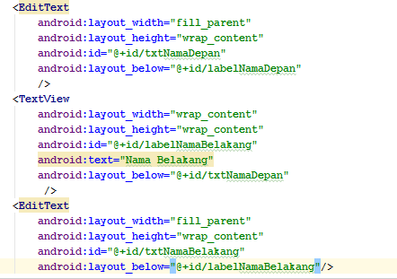
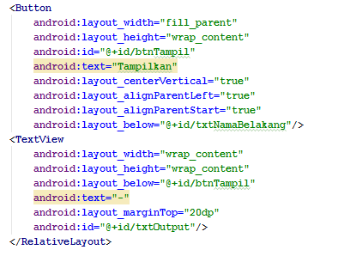
File : activity_main.xml

Slide 6
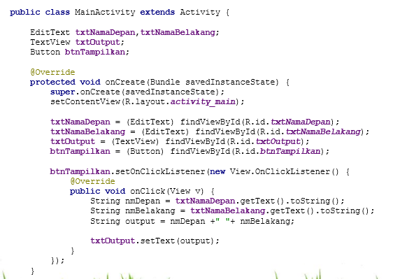
File : MainActivity.java

Slide 7
Tugas terstruktur
Buatlah program kalkulator sederhana dengan menggunakan symbol aritmatika dan designlah xml seperti contoh pada slide berikut!

Slide 8
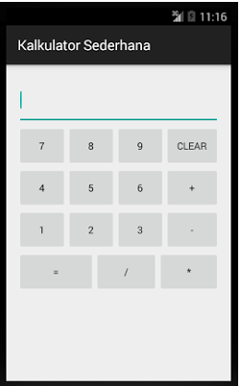
TUGAS TERSTRUKTUR

